Slide 1
When you want to tell somebody something, but not sure how…

Slide 2
Helping you to meet your emotional needs

Slide 3
Where did the idea come from?
Why vOUCHers?

Slide 4
Background

Slide 5
Where did the idea for
come from?
The idea stemmed from a conversation with one of the authors 10 year old daughter, who desperately needed to tell her mum something.
“Go on, I am listening,” said the mum.
“Mum, I went on a website I shouldn’t have.”
The mum gave her silence and verbal space to allow her to tell her more. It transpired that it was an innocent site. No harm done.
“Are you angry with me, mum? ” Her daughter asked.
“I am really pleased you told me.” said the mum.
They carried on talking and her daughter explained that it happened over a week ago:
“I was worried because you’d told us the rules of being online and I broke them. I thought you’d be angry ”
Notes:
It started from a conversation with one of the authors 10 year old daughter.
At the start of the 2020 March lockdown, the mum spent time talking through internet safety with her children, aged 10 and 7, going through what the school had told them, ready for online learning.
All seemed to go well for 3 weeks until one evening, as the mum was tucking her 10 year old into bed, her daughter announced that she needed to tell her something. Her look was of fear, her words were shaky.
“Go on, I am listening,” said the mum.
“Mum, I went on a website I shouldn’t have.”
The mum stayed quiet and her daughter went on to explain that she had looked at a website she had seen an advert for. One she hadn’t had permission for.
“Are you mad at me, mum?” Her daughter asked.
They carried on talking and her daughter explained that it happened over a week ago: “I was worried because you’d told us the rules of being online and I broke them. I thought you’d be angry.”

Slide 6
Why vOUCHers

Slide 7
Why
Helping people to meet their emotional needs
In fact, the mum wasn’t angry.
Why do you think she was not angry?
Why do you think the daughter was feeling worried?
What other feelings might the daughter have felt over the week from when it happened to when she told her mum?
Think of faces & emotions that could go here.

Slide 8
Why
Helping people to meet their emotional needs
Have you ever felt scared to tell someone something?
Has something like this happened to you that has made you feel worried to tell someone?
Do you sometimes come to school and want to talk to someone but don’t know where to start?
Do you sometimes have a worried, angry or other feelings, but you don’t know why?
What other feelings do you sometimes feel?

Slide 9
Resources

Slide 10
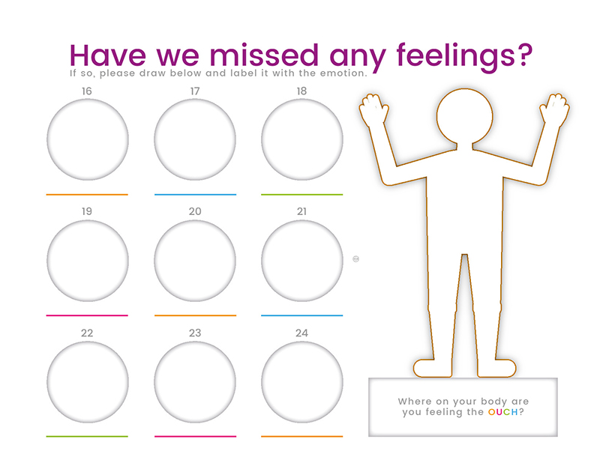
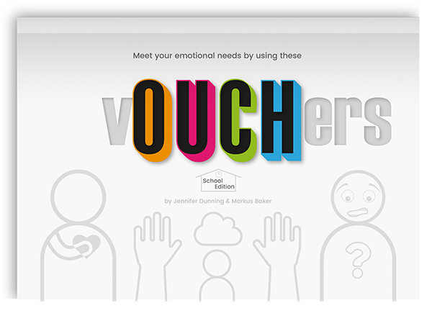
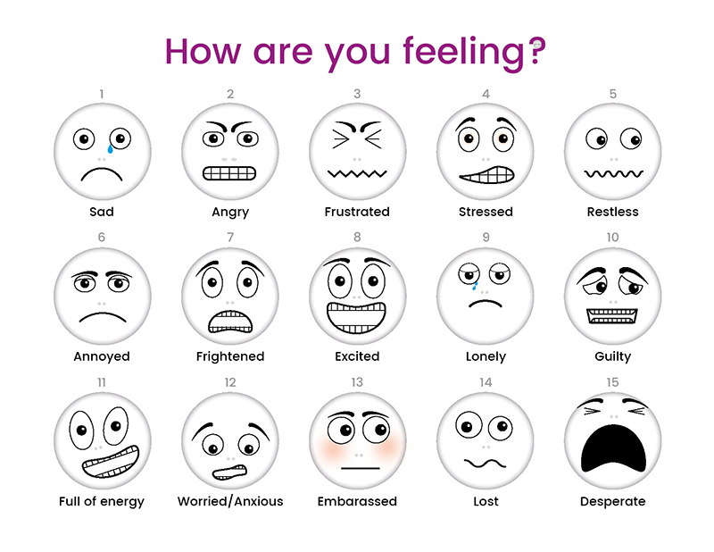
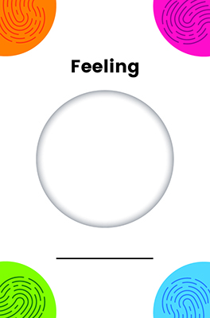
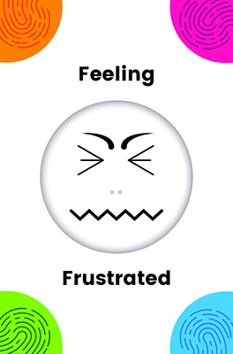
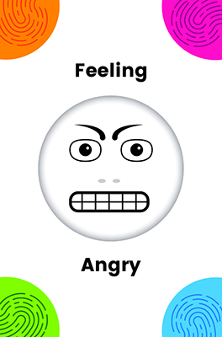
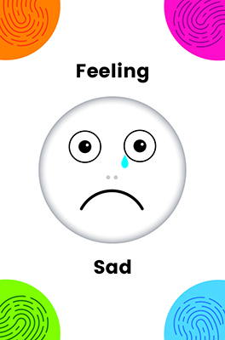
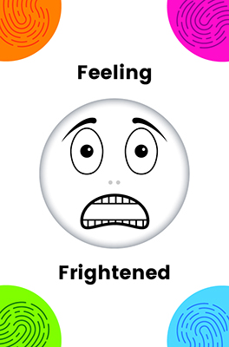
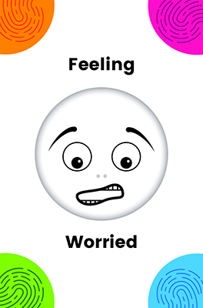
If so, can help
School and class posters
Laminated feelings pages
Symbol Exchange Cards
vOUCHers book with 16 different vOUCHers
Learn more at www.OUCHer.net

Slide 11
How to use them

Slide 12
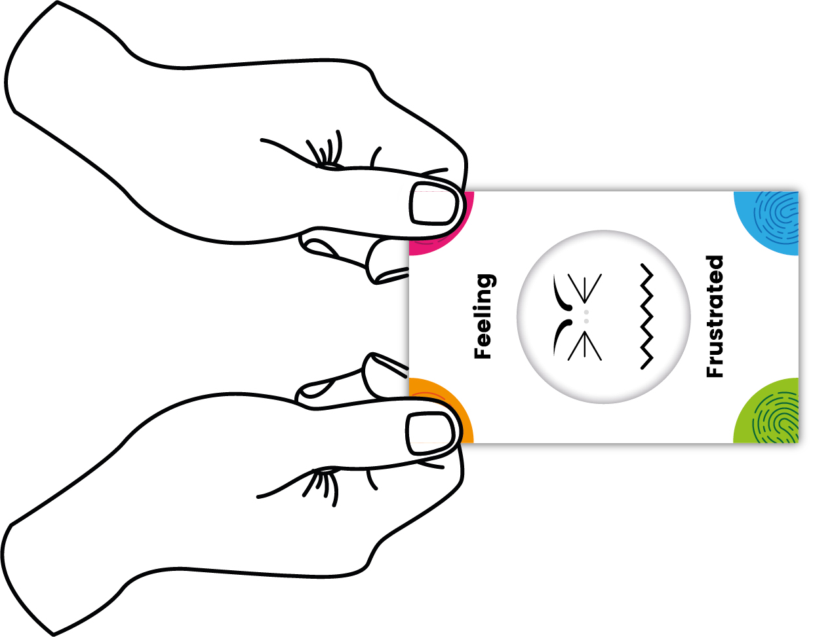
Symbol Exchange Cards (SEC)
If given a SEC and the feeling represents how you are feeling take the card to chose your vOUCHer.
The person who gives you the SEC will do so with two hands to show how important it is
If the SEC does not represent how you are feeling either say how you are feeling or turn the card upside down.
The SEC has four colourful corners that show where to hold the card . If you wish you can accept the card with two hands.
Notes:
The PEC has four corners. Offer the card using two hands to show the significance of their feelings. Even if the child does not take it with two hands, offering it this way shows importance that you are putting energy into the exchange.
When the child gives the PEC to the nominated adult, accept the card with two hands to acknowledge the importance of the exchange. Avoid rushing, allow yourself the time to slow the pace for the child.
The pictorial exchange card (PEC) is designed to have some weight to signify it’s importance. Should you feel the child needs the card to have more weight, a blob of tak may be needed to weigh it down more.

Slide 13
How to use the
Each vOUCHer folds in to a self contained envelope for privacy & to leave somewhere to be found. www.oucher.net/voucher-folding/
Each book has 2 of the 16 different vOUCHers
To personalise the vOUCHer or If it can not be given in person, the ‘to ‘and ‘from’ names can be written on the back
Notes:
Consider if there is going to be a nominated vOUCHer exchange person in each class or in the school. This person could then record the use and types of emotions felt to monitor times needed in the day / week / how they self soothed etc.
Each book has 32 vOUCHers. There are 16 different vOUCHers and each book has 2 of each of those vOUCHer.
Each vOUCHer folds in to a self contained envelope for privacy and to enable it to be left somewhere to be found by the recipient. Learn how to fold the vOUCHer at https://www.oucher.net/voucher-folding/

Slide 14
Using vOUCHers at our school

Slide 15
How we will use …
…at our school
Notes:
Share the specifics of how your school will use vOUCHers.

Slide 16
Helping you to meet your emotional needs

Slide 17
www.OUCHers.net

