Slide 1
A resource to aid emotional literacy and intelligence

Slide 2
A “How to”
Presentation for Staff

Slide 3
Agenda
Background to the initial idea
The aims
The resources
How to use them
How we will use them

Slide 4
Background

Slide 5
Background to the initial idea
The idea stemmed from a conversation with one of the authors 10 year old daughter, who desperately needed to tell her mum something.
“Go on, I am listening,” said the mum.
“Mum, I went on a website I shouldn’t have.”
The mum gave her silence and verbal space to allow her to tell her more. It transpired that it was an innocent site. No harm done.
“Are you mad at me, mum? ” Her daughter asked.
“I am really pleased you told me.” said the mum.
This led the mum to think, if her own daughter held this worry inside her, other children may also. So she created vOUCHers.
Learn more at www.oucher.net/how-vouchers-started/
Notes:
The idea stemmed from a conversation with one of the authors 10 year old daughter. At the start of the 2020 March lockdown, the mum spent time talking through internet safety with her children, aged 10 and seven, building upon their school’s teaching. All seemed to go well for three weeks until one evening, as the mum was tucking her 10 year old into bed, her daughter announced that she had needed to tell her something. Her look was of fear, her words shaky.
“Go on, I am listening,” said the mum.
“Mum, I went on a website I shouldn’t have.”
The mum gave her silence and verbal space to allow her to tell her more. Her daughter went on to explain that she had accidentally clicked on a pop up site. It transpired that it was an innocent site. No harm done.
“Are you mad at me, mum?” Her daughter asked.
The conversation continued and her daughter explained that it happened over a week ago and she had not had the courage to tell her mum, worried about what she would say: “I was afraid to tell you because you’d told us the rules of being online and I broke them. I thought you’d be angry.”
This led onto the mum to think, if her own daughter held this worry inside her and, in fact, a very innocent fear from an action that in this instance led her to no danger, what of other children who have similar secrets, or indeed secrets of a grander, more serious scale. Potentially of trauma, fear and real danger, but not have anyone to tell.
Following discussions with a friend, they went on to create the home edition of vOUCHers. This became a small scale success and, responding to the feedback from a number of those who had bought it and, working with a number of schools, created a schools edition: A version that could be created to help children recognise and manage their feelings; be safe in the knowledge that they would be listened to, all in a way that helps develop emotional literacy; to help to resolve their emotional OUCH.

Slide 6
Aims

Slide 7
aims
To develop emotional intelligence and literacy
To identify and explore how emotions feel in the body
To give permission that feelings and emotional language is allowed and the norm
Validate feelings at the time
Encourages talking about feelings
Encourages listening without judgement or trying problem solve all the time
Encourages children to recognise and accept the feelings and emotions in others
To help children recognise that when there is a problem, talking can help
Develops relationships in school
Encourages the child to take ownership and responsibility of their emotions and feelings
Encourages the recognition of problem solving sometimes takes time / reduces impulsivity
Helps start difficult conversations
Gives the child confidence that they will be listened to
Allows communication without words
This is not an exhaustive list of what could be achieved, by using the vOUCHers in school. Further links to Personal Social Emotional Develop (PSED) strands can be found on the website – www.OUCHers.net

Slide 8
Resources

Slide 9
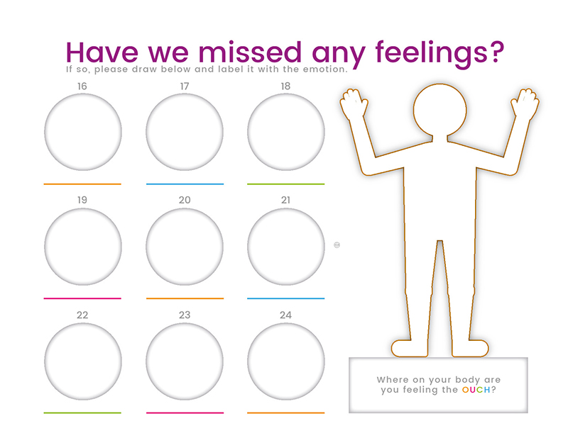
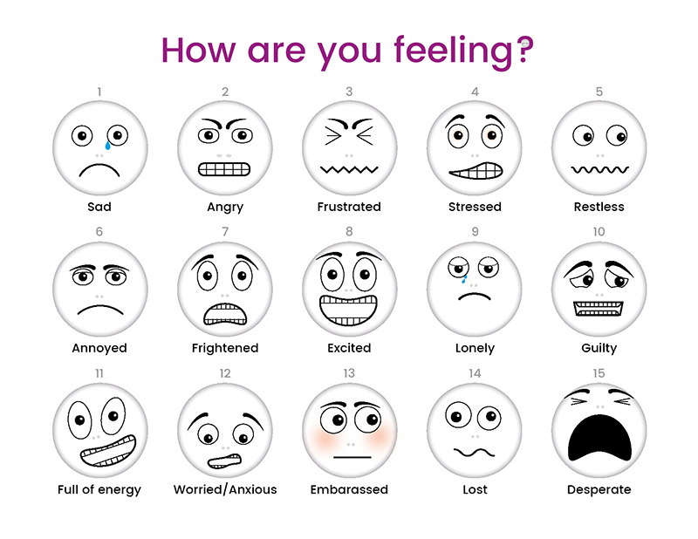
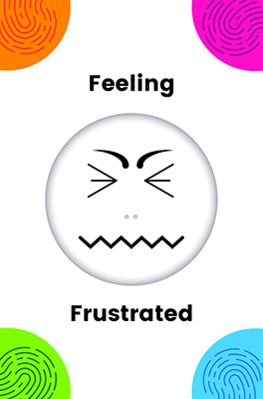
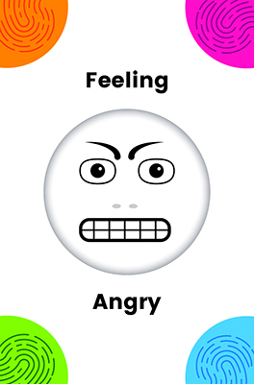
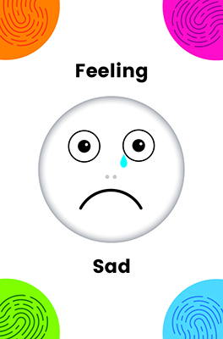
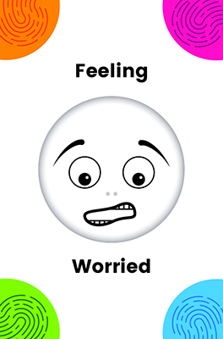
resources
Children’s Assembly Presentation
Laminated feelings pages
Staff ‘How to’ Presentation
Symbol Exchange Cards
vOUCHers book
School and class posters
Learn more at www.OUCHer.net

Slide 10
How to use them

Slide 11
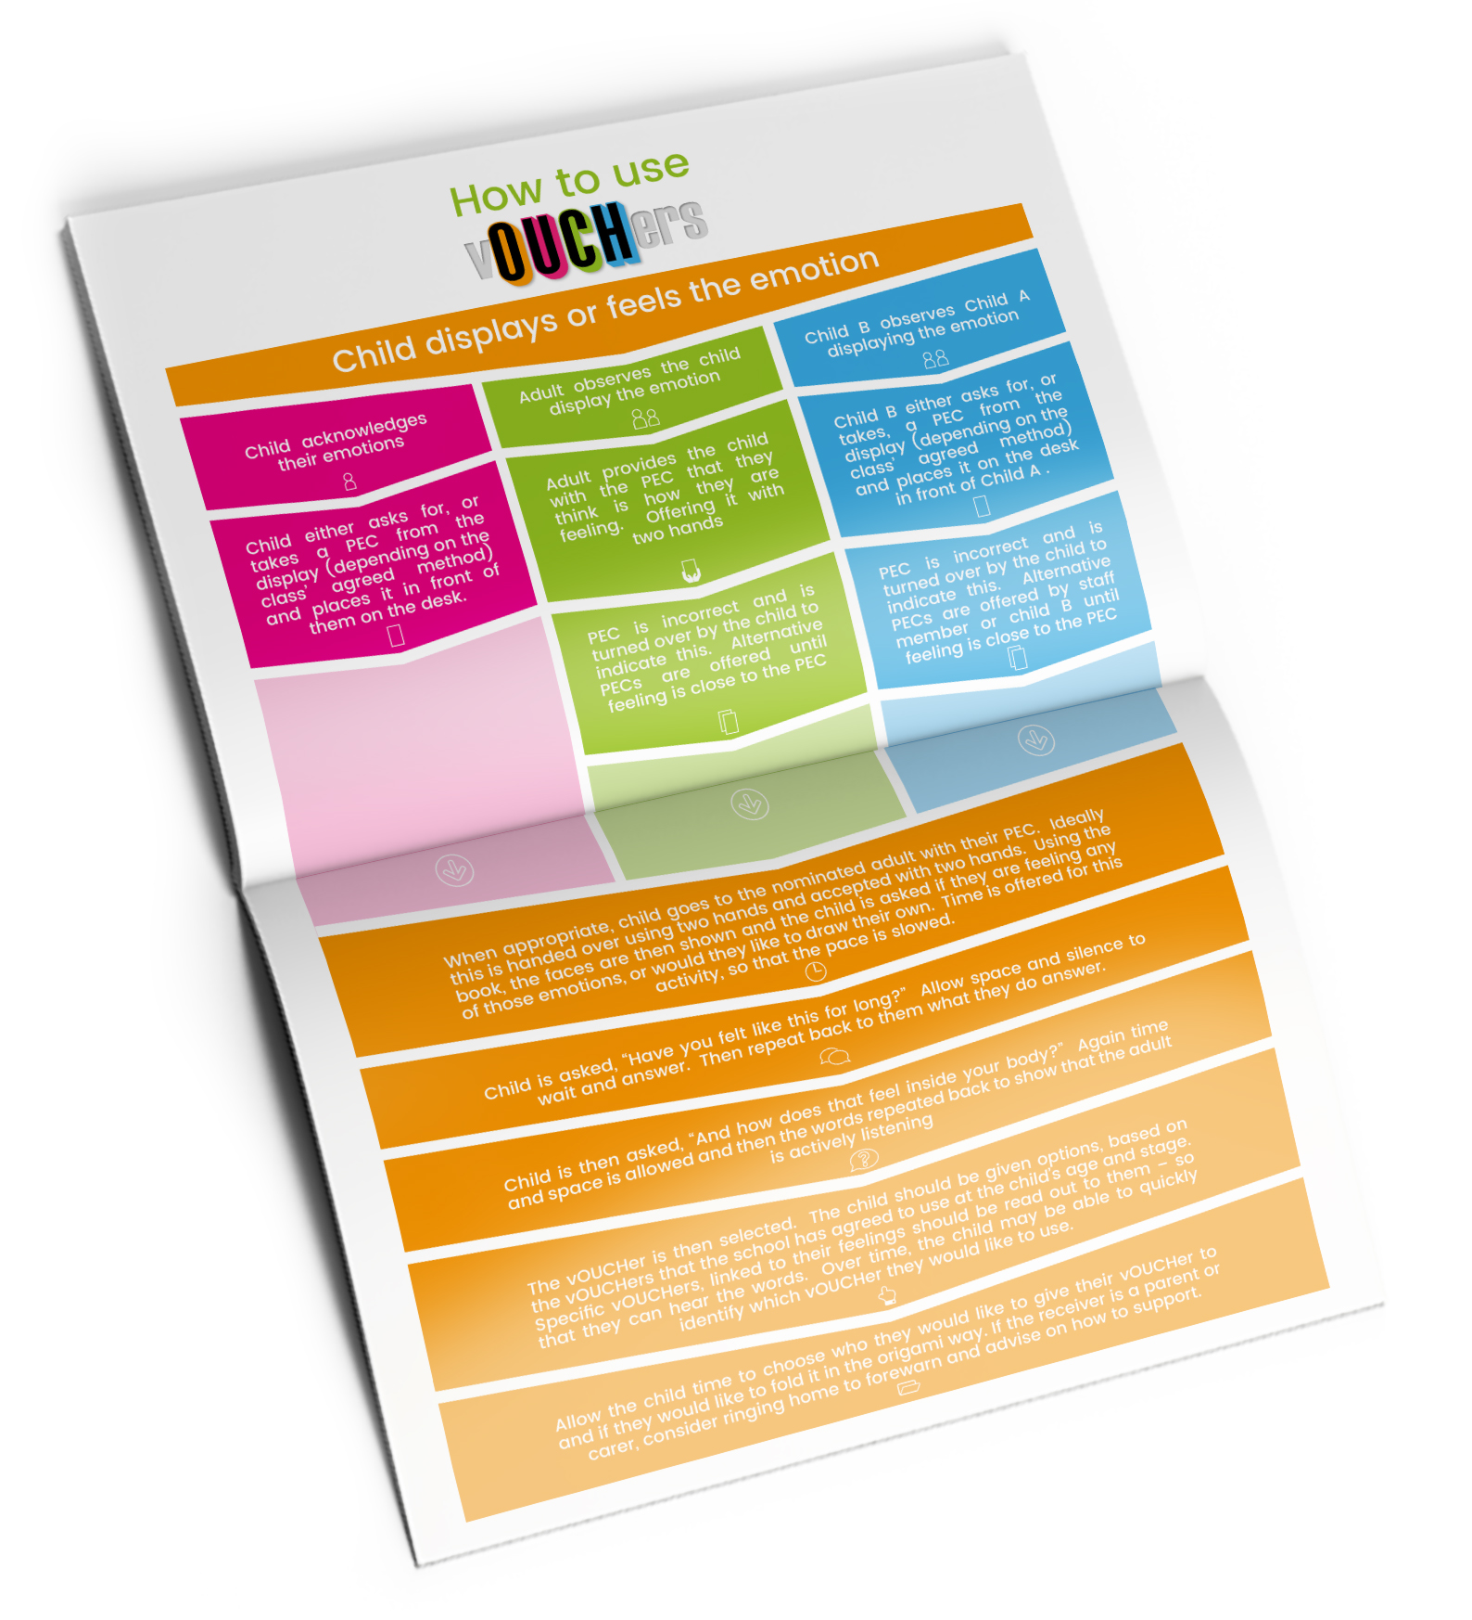
How to use
Please turn to page 4 in the School Edition of the book to see the Flow Diagram.

Slide 12
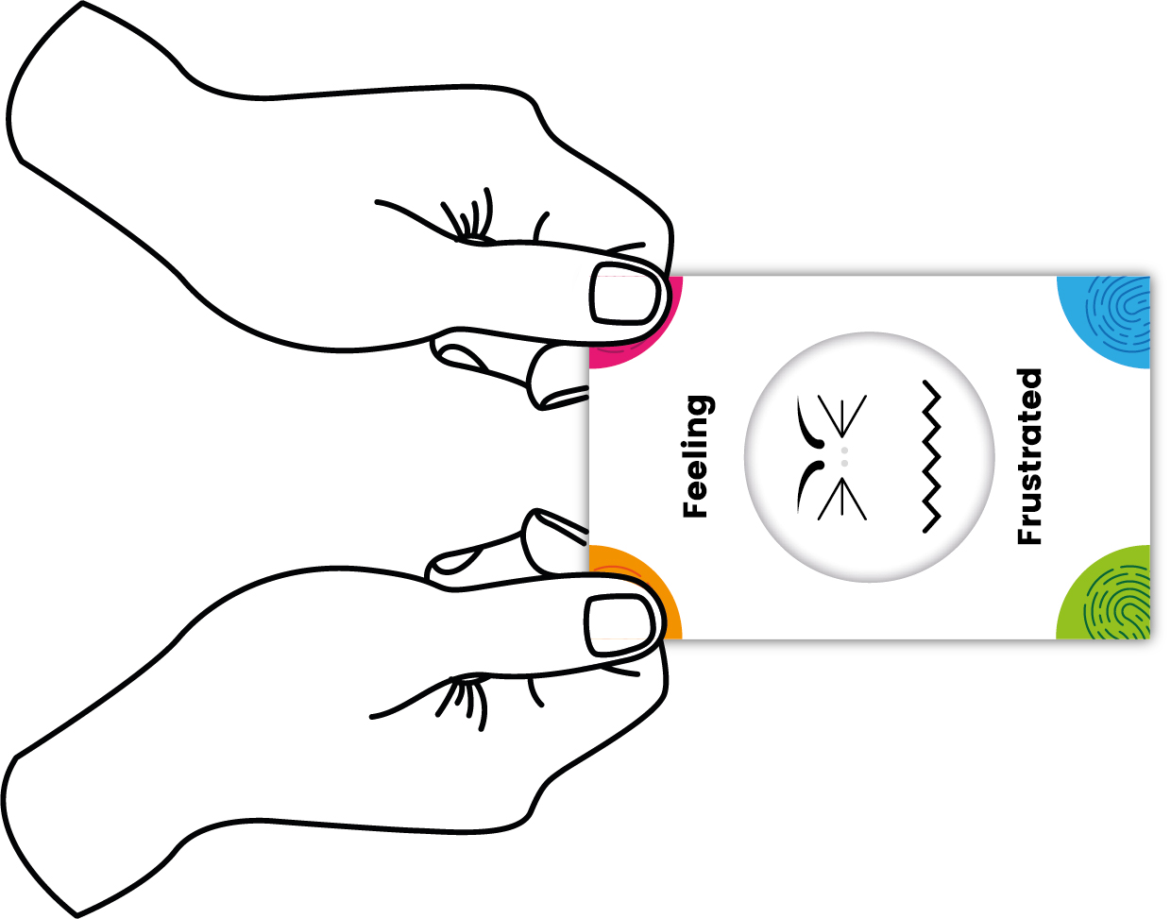
Symbol Exchange Cards (SEC)
Always offer and accept the SEC card with two hands to show the significance of their feelings.
When givng the SEC ensure the face and words are legible & not upside down.
Thick card and weighted design signify it’s importance.
The SEC has four colourful corners that show where to hold the card
Notes:
The SEC has four corners. Offer the card using two hands to show the significance of their feelings. Even if the child does not take it with two hands, offering it this way shows importance that you are putting energy into the exchange.
When the child gives the SEC to the nominated adult, accept the card with two hands to acknowledge the importance of the exchange. Avoid rushing, allow yourself the time to slow the pace for the child.
The Symbol exchange card (SEC) is designed to have some weight to signify it’s importance. Should you feel the child needs the card to have more weight, a blob of take may be needed to weigh it down more.

Slide 13
Exchanging a SEC
Verbally acknowledge the SEC with scripted agreed phrases.
I am giving this card to you with two hands, because how you are feeling is important to me.
When giving a SEC
I am accepting this card with two hands because I care about how you feel.
When accepting a SEC
Notes:
Verbally acknowledge the SEC. Scripted agreed phrases such as:
“I am giving this card to you with two hands, because how you are feeling is important to me.”
“I am accepting this card with two hands because I care about how you feel.”

Slide 14
How to use the
Select which of the 16 vOUCHers are best for each of the class settings on page 3 of the book.
Notes:
Not all vOUCHers will be appropriate in all settings or all stages. We will discuss which ones would be best as a team, then tick the listed vOUCHers on the contents page as a reminder of which ones to use.

Slide 15
How to use the
Each vOUCHer folds in to a self contained envelope for privacy & to leave somewhere to be found. www.oucher.net/voucher-folding/
Each book has 2 of the 16 different vOUCHers
To personalise the vOUCHer or If it can not be given in person, the ‘to ‘and ‘from’ names can be written on the back
Consider having a nominated vOUCHer exchange person in each class or school to monitor emotional needs in the class or school
Notes:
Consider if there is going to be a nominated vOUCHer exchange person in each class or in the school. This person could then record the use and types of emotions felt to monitor times needed in the day / week / how they self soothed etc.
Each book has 32 vOUCHers. There are 16 different vOUCHers and each book has 2 of each of those vOUCHer.
Each vOUCHer folds in to a self contained envelope for privacy and to enable it to be left somewhere to be found by the recipient. Learn how to fold the vOUCHer at https://www.oucher.net/voucher-folding/

Slide 16
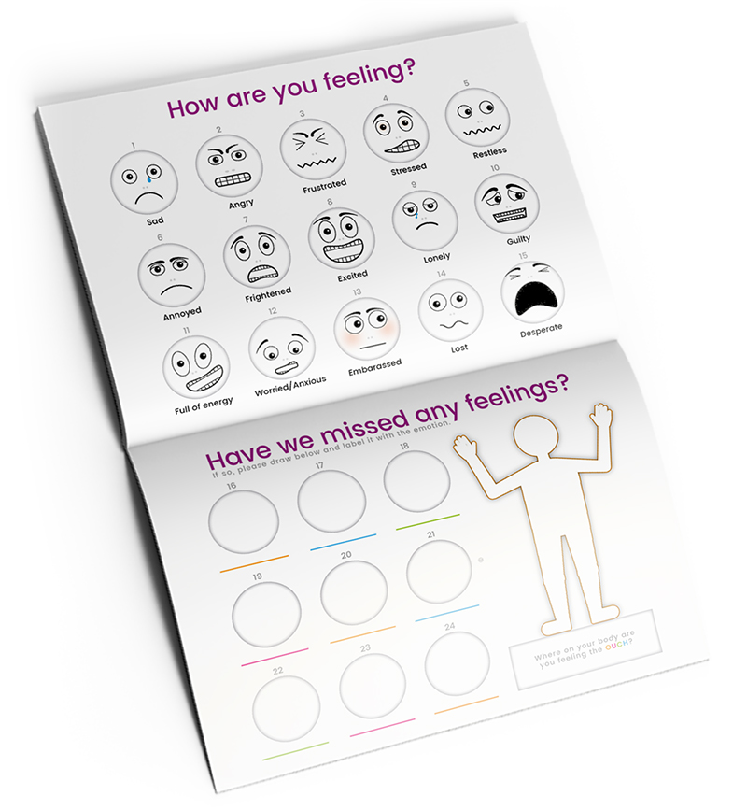
How to use the
Some children may need additional support as soon as the PEC has been offered.
Use a physical timer you have in school to give space to feel the emotions.
Using the face pages and descriptions of where the feelings are can help.
Use page 8 & 9 of the book or the laminated sheets in the vOUCHers pack.
Notes:
Some children may need additional support as soon as the PEC has been offered.
Visual timers can give children space to discover how they feel and what they would like to say and can also let them know when the trust grown-up will be available to give them their full attention. It encourages them to wait for 1, 2, 3, 5, 7 or 10 minutes. Other children may be able to wait until the end of the learning session. Learn more at www.oucher.net/timers
The faces pages can be laminated to allow touching, pointing, and drawing on the blank faces and body outline using a drywipe pen. If needed, this can then be photocopied to consider progress over time with emotional literacy development.

Slide 17
Tips for using
Avoid leading the conversation.
Use silence and space to empower the child
Slow pace to help the child find the correct vOUCHer for them.
Help the child to find their own solution before providing any answers.
Enable child to acknowledge and feel their emotions.
Remember it is them who are resolving the situation.
Read their chosen vOUCHer to them – even if they can read well – to allow the auditory senses to be used.
Notes:
When suggesting vOUCHers based on their emotions, avoid leading the conversation. Silence and space whilst the child thinks is important. Pace can be slowed down. This can be the hardest part as we are often led to wanting to resolve solutions. That is not the aim, we are developing the idea that silense and space to acknowledge feelings are equally – if not more – important. Once the child spends the vOUCHer with their chosen nominated person, that is when THEY are resolving the situation.
When deciding on the vOUCHers, read it to them – even if they can read well – to allow the auditory senses to be used.

Slide 18
Using vOUCHers at our school

Slide 19
Benefits & Positives
What are the benefits and positives vOUCHers will bring to our school?
Notes:
Lead a discussion on the positives

Slide 20
Specific Considerations
What are the specific considerations to us as a school?
Notes:
Lead a discussion on the considerations

